Slide 1
Governmental Services: what’s the NGO’s Role
Ideas for future research
Matthias Meyer
Institut for Nonprofit and Public Management
Notes:
Today, I can’t describe the results of a finished research project. Instead I will present some Ideas for future research in the field of Governmental Services – what’s the NGO’s Role with the hope to be able to learn in the discussion from your ideas and feedbacks. And perhaps you have similar ideas like I have and we can do some research work together.

Slide 2
Structure of the presentation
Definitions Municipality / Community / Parish
Governmental services
NGOs as partners for Governmental services
Public services Within the public administration
Outsourcing
New Public Management for communities
Basis for future research
Interesting research topics
Used literature

Slide 3
Definitions
Municipality / Community / Parish
Governmental services
  Legal base
    Duty
    Voluntary
NGOs as partners for Governmental services
  Profit – Not for profit
  Legal Status
Notes:
There are different words for the smallest federal unity - in German as well as in English. While in German very often «Gemeinde» or «Kommune» are used the English language uses «municipality», «community» or even «parish». Doing a research in this field, the definition of the used term must clearly state that it is the smallest federal, political unity that is in the focus of our work. And not a religious unit or a traditional community of the citizen's of a place. In the German language the terms “Gemeinde” or “Kommune” have different meanings, too. In Switzerland we distinguish between “politischer Gemeinde” (or “Einwohnergemeinde”, “Munizipalgemeinde” or even “Bezirk” (Kt. Appenzell Innerrhoden), “Bürgergemeinde” and “Kirchengemeinde”. In addition the word “Kommune” has two meanings: the political community and a group of people living together.
I am using the word community and I mean with it the smallest federal unity in Switzerland: The communities have an own budget, political leaders for the administration (Gemeinderat). The inhabitants of a community are by definition members of it (pay taxes, are allowed to use services and if they are Swiss, they are allowed to vote and to elect / get elected).
Governmental services: A public administration is only allowed to get active if there is a legal base for an activity. The law can specify two different forms: duty (the community runs a service of…) or voluntary (the community can promote …). Therefore a Governmental service always has a legal base and the corresponding law defines the limits for the service. It doesn’t matter who (private or public) is providing the governmental services. In our fast-developing world the need for a legal base for governmental action creates different problems which leads all to the situation that the administration is not allowed to act even when there is a need for it.
In addition, the principle of subsidiarity has in Switzerland very high priority. On horizontal level this principle demands that in principle all services should be done by private initiatives and the state only get active if there is a clear public need and no private offer. On vertical level the principal of subsidiarity demands that a service should be on the lowest governmental level possible.
There are no general limitations that NGOs are not allowed to make profit by doing governmental services. It is not even indicated by the law that it must be a NGO who is doing certain public services. Public tasks like security, handling of garbage or running the asylum centres are more and more done by for profit organisations.
In the literature we can not find a clear definition for Non Governmental Organisation or for Non Profit Organisation. Therefore the used term needs to be defined clearly: not part of the government (privat and not public organisation), profit or not for profit orientated. Other criteria's could be: ownership, legal form of the organisation like registered society, fundation, cooperative, public limited company or joint body (of local authorities for joint mastering of certain tasks).
Since there are a lot of different private organizations (legal form, profit and not for profit) which are doing public services, it is important to define which ones are considered within a research project.

Slide 4
Public services
Communities do about 25% of the public services in Switzerland
Halve of the communities in Switzerland have about 1100 inhabitants or less and therefore a lot of problems to do the public services correctly by their own.
New Challenges by providing public services
Public organisations can do the services by themselves or they can outsource them on contractual base (depends on the legal base)
Notes:
In Switzerland, the cantons are the main supplier for public services (42,3% of the total expensure for public services in Switzerland). The Federal Government has a proportion of 33,6% and the communities spend 24,1% of the total expenditure for public services in Switzerland in 2010 (Ladner A., 2013). By comparing this distribution with other countries we always have to keep in mind, that in Switzerland, 8 cantons have less than 100’000 inhabitants and half of the cantons have less then 200’000 inhabitants (BFS 2015). These amounts of inhabitants represent in the most European Countries small villages.
In Switzerland the Cantons define the communities by a special law. The cantons can even force the communities to merge (voting on Canton level). Therefore also the duties of the communities regarding the public services were decided on Canton level and are therefore different from Canton to Canton. Especially in smaller Cantons there are quite a lot of services in the responsibility of the Canton and therefore central organised.
Switzerland has about 2300 communities. The biggest one is Zürich with about 385’000 inhabitants, the smallest one is Cirripo (TI) with 12 inhabitants. The median is by 1023 inhabitants, the average is by 2806 (in 2007) (BSF ESPOP). This figures are today a little bit higher, due to mergers, and need to be recalculated.
Small communities have different problems to produce public services:
They have not enough personnel to employ specialists: In Neuheim, the smallest community in the Canton of Zoug, there is one person responsible for all the social questions: with a half-time job. And Neuheim has 2800 inhabitants. So imagine the situation in communities with 1000 inhabitants or less. Very often, small communities have an administration with only one or two employees.
Small communities often have a problem with big investments: expensive, special cars (for the fire brigade, garbage, snow-cleaning), but also installations like water supply or district heating.
And finally, there are public services like the fire brigade that are traditionally organised on voluntary base. Small communities have very often the problem to assure such a service, because they don’t find enough volunteers for their own fire brigade.
So we have the challenges of providing services due to the size of the community (small amount of staff within the administration), due to the size of the needed investment and due to the amount of inhabitants which are willing to serve as a volunteer.
And to this trickiness for the small communities we can add the challenges coming from the general change within the society: the technical development, the raise of needs for public services with a gap in the tax income, change of the expectations of the citizens (want to be served as client, less willingness to act as volunteer) and the changes due to New Public Management (Wirkungsorientierte Verwaltungsführung).
The “Gemeindeschreiberbefragung” in 2009 can give us indicators on the distribution of the personal within the community administration and the personal of outsourced services. Since the school-services have a lot of personal (teachers), in the following figures the educational sector is excluded. All communities (which have answered) with less than 10’000 inhabitants (in Switzerland about 2300 communities) have at least 75% of the needed personal spined off. The communities between 1000 and 5000 inhabitants have even more personal spined off than in the one administration.

Slide 5
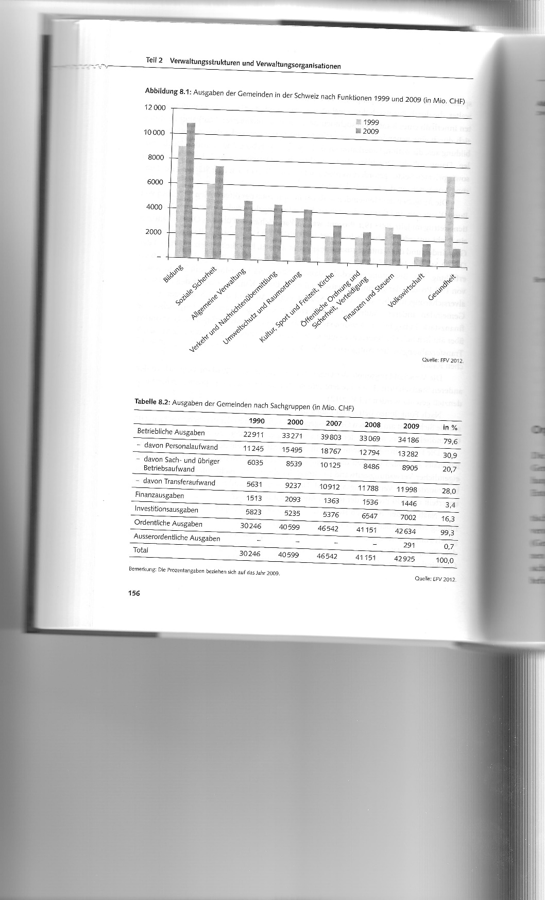
Fields of community activities
Steiner R. und Kaiser C. (2015). S. 156
Notes:
Education und social security are the most cost intensive sectors of community activities. But already the amount of 10 different sectors shows the challenge that specially small communities meet.
Between 1999 and 2009 a lot of hospitals were taken out of the responsibility of the communes and the Canton has taken the responsibility of the hospitals for a better coordination of the health care. This has reduced the health costs of the communities strongly.

Slide 6
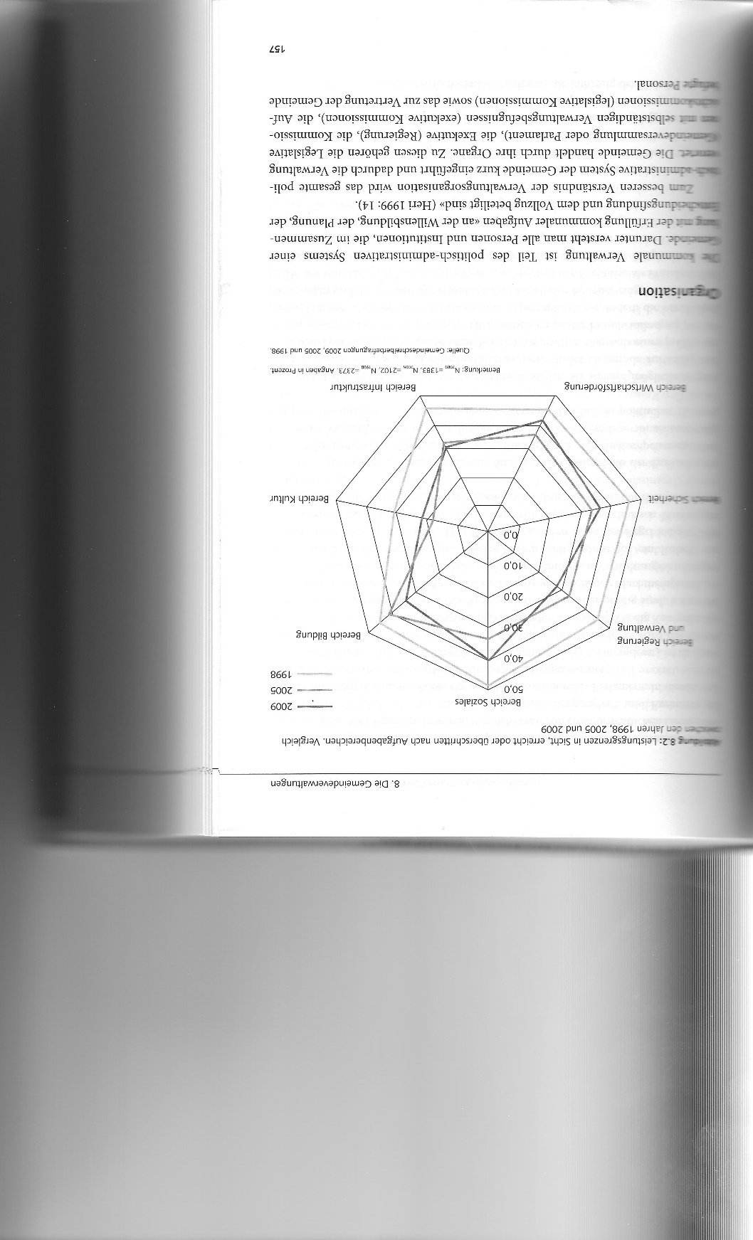
Limits of the performance of the communities
Steiner R. und Kaiser C. (2015). S. 157
Notes:
During the last 10 years the communities reach clearly less often their limits by providing public services. After a clear easing of the situation in 2005, the tension became stricter in 2009 again. Specially in the sector social where about 40 % of the communities report that they reach their limits by providing public services.

Slide 7
New Public Management for communities
Reorganise the management: From input-controlled to target-controlled
Doing things together
Spin off tasks to privat organisations
Notes:
During the last 15 years a lot of communities had projects to improve their way of managing the public services. But these were mainly the bigger communities. The other just don’t have the resources for bigger projects. And resources means not only money, it means also experts within the organisation which are able to run and advocate it.
The projects towards a new public management (Wirkungsorientierte Verwaltungsführung) had mostly the aim to came away from an input-control (the one-year budget is steering the administration) of the public administration and come to an target-control steering of the administration. This includes also to define clearly the tasks and services of the state (SMART definition of the targets). This is of course a political process and in the most communities, this processs has only just begun.
The smaller communities intensified during the last ten years their cooperation's (Interkommunale Zusammenarbeit - IKZ). Merging communities was an other option during the last decade:
The communities in the Canton of Glarus merged to three big communities (2006).
Between 2000 und 2006 the Canton Fribourg hat 41 community-mergers with total 118 communities involved.
The Canton of Berne reduced the amount of communities from 2000 until 2015 from 400 to 353 (- 12%)
But a lot of projects of community mergers were in this period also rejected by the citizens (greater Luzern, greater Emmen, BS/BL a.so.). And for the future it doesn’t look too good. Therefore the cooperation's become even more important.
The third way for a community is to spin off parts or whole public services. The partner is then a private person or organisation. This can be a non-profit or a for-profit organisation. And this outsourcing can happen on very different levels:
Running a centre for asylum seekers (for example Caritas)
Doing expertise’s in the process for a building permission (for example by a local architecture)
The primary health care by a local doctor for the regional old people’s home
Doing the snow removal for the community (by local farmers)
a.s.o.

Slide 8
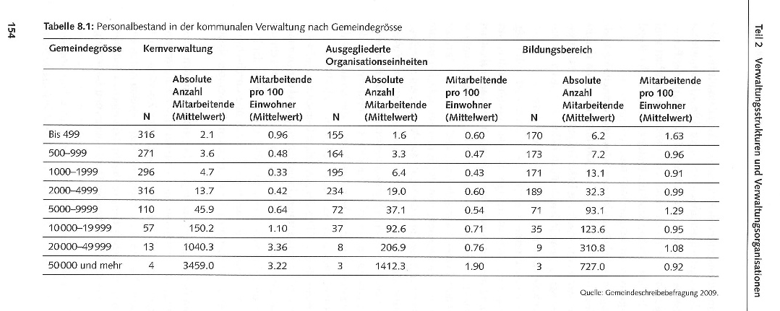
Distribution of personal
Steiner R. und Kaiser C. (2015). S. 154
Notes:
Regarding the personal, it is obvious that a lot of public services are done by private persons or organisations. The most critical size for a community seemed to be 1000 – 5000 inhabitants. In this group of communities there are more employees outside of the public administration then inside of the public administration financed by the community. But also for the bigger communities, the personal financed by the state but employed by private organisations has an important number:
20000-49999 inhabitants: 16% of all personal working for the community are private employed.
50000 plus inhabitants: 29% of all personal working for the community are private employed.

Slide 9
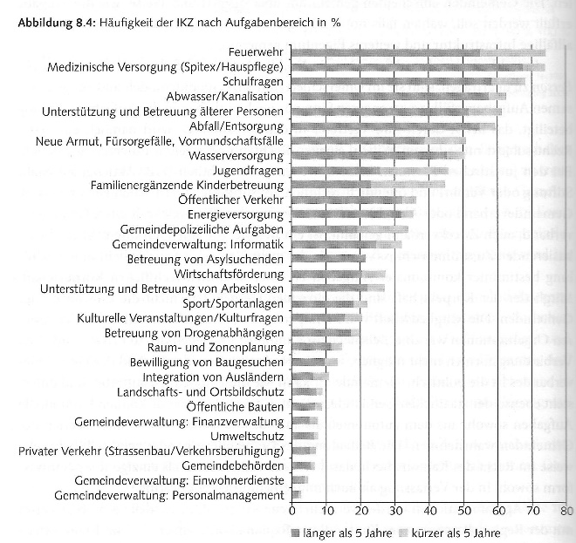
Fields of activities for cooperations of communities
Steiner R. und Kaiser C. (2015). S. 164
Notes:
When communities cooperate in a specific field they often use an existing or they establish a new organisation. This organisations are mainly non-profit orientated but can have very different legal status: public limited company, cooperative association, charitable organisation and foundation under public law are the most common legal status of this organisations.
They have all in common that a contract between them and the community is defining the public service they should deliver. This private contract is not under the direct control of the citizens and the policy or strategy of the organisation can not be influenced by the citizens. Therefore there is a decrease of the democratic influence. In addition the process to finalise such a contract is specially for private organisations not owned by the community very often very laboriously and needs a lot of paper work. The social and health promotion organisations with a contract with the Canton of Zoug had normally more than 15 months to get a new 3 years contract for their services. Finding a new way of working together is in my opinion absolutely necessary.

Slide 10
Basis for future research /1
Literature: There is a good basic of models in the international literature but the Swiss situation is very special and most of the models need to be adopted (New Public Management is in Switzerland Wirkungsorientierte Verwaltung)
The Swiss literature is mainly very specific and take the Cantons and the bigger communities in focus. There is very little literature / research on small communities.
Their is no research on the importance of the NGOs for the public services of small communities available. A first project has been proposed this summer to the Gebert Rüf Foundation (2 years project).

Slide 11
Basis for future research /2
Field-Access With the Gemeindeschreiberbefragung exists a regular monitoring on global topics of the Swiss communities. This research is done by the KPM, Bern.
The cantons and also the communities should have a list with all their partners which are doing a public service (Öffentlichkeitsprinzip).
There are other registrations, like the IVSE (Interkanonale Vereinbarung für soziale Einrichtungen)

Slide 12
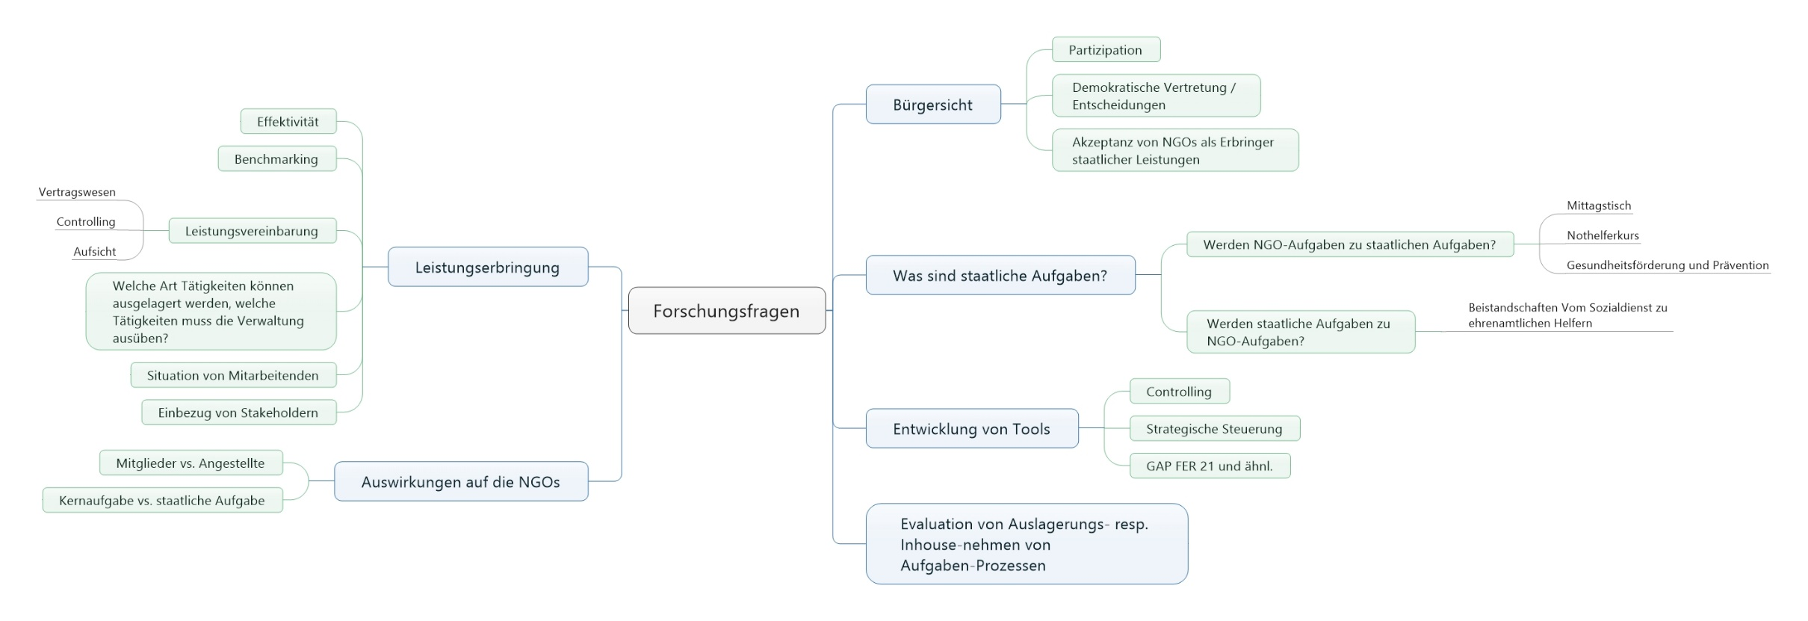
Interesting research topics

Slide 13
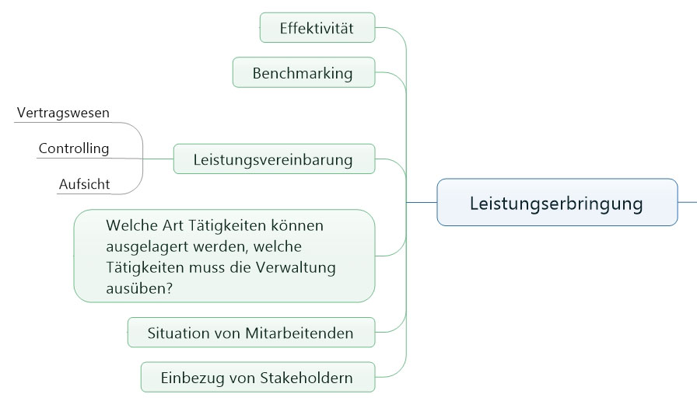
Interesting research topics

Slide 14
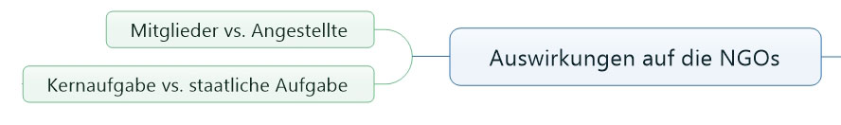
Interesting research topics

Slide 15
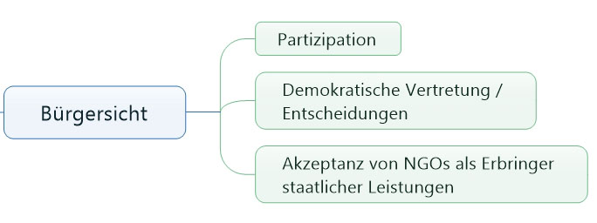
Interesting research topics

Slide 16
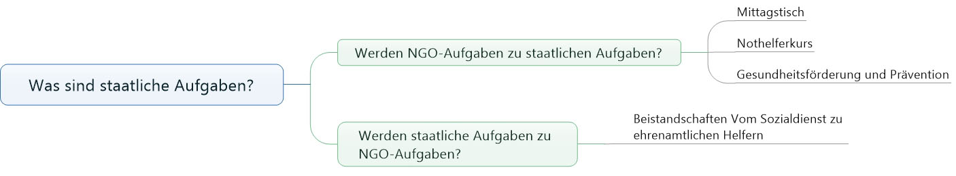
Interesting research topics

Slide 17
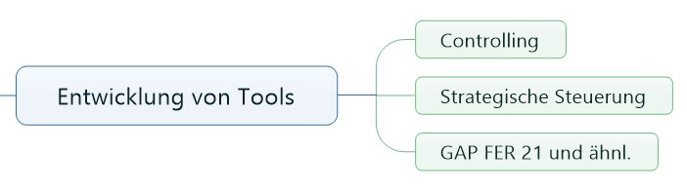
Interesting research topics

Slide 18
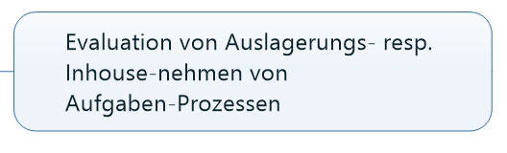
Interesting research topics

Slide 19
Used Literature
BFS – Bundesamt für Statistik (2015). Ständige Wohnbevölkerung nach Kantonen. http://www.bfs.admin.ch/bfs/portal/de/index/themen/01/02/blank/key/raeumliche_verteilung/kantone__gemeinden.html. Aufgerufen am 4.10.2015.
Ladner, A. (2015). Der Schweizer Staat, politisches System und Aufgabenerbringung. In: Ladner A., Chappelet J.-L., Emery Y., Knoepfel P., Mader L., Soguel N., Varone F. (2015). Handbuch der öffentlichen Verwaltung der Schweiz. Verlag Neue Zürcher Zeitung, Zürich.
Ladner A., Chappelet J.-L., Emery Y., Knoepfel P., Mader L., Soguel N., Varone F. (2015). Handbuch der öffentlichen Verwaltung der Schweiz. Verlag Neue Zürcher Zeitung, Zürich.
Steiner R. und Kaiser C. (2015). Die Gemeindeverwaltungen. In: Ladner A., Chappelet J.-L., Emery Y., Knoepfel P., Mader L., Soguel N., Varone F. (2015). Handbuch der öffentlichen Verwaltung der Schweiz. Verlag Neue Zürcher Zeitung, Zürich.

